Slide 1
Renal disease

Slide 2
RENAL FAILURE
Classification :-
Onset
A. Acute Renal Failure – days or weeks
B. Chronic Renal Failure – period of years
Location
A. Pre renal failure
B. Renal or Intrinsic failure
C. Post renal failure

Slide 3
A. ACUTE RENAL FAILURE:-
Severe azotemia, common in hospitalized pt.
Causes: - Medication, Surgery, pregnancy – related complications, trauma etc.
Clinical Course:-
Stage 1:- oliguria (urine vol. <400ml / day)
Stage 2:- diuresis ( urine > 400ml / day)
Stage 3:- Recovery

Slide 4
Causes of ARF are divided into three categories
1.Pre renal failure :- without permanent physical injury to the kidney
2.Post renal failure :- Less common, obstruct the flow of urine, common in older men
3.Acute intrinsic renal failure :- Glomerular, vascular & tubulo interstitial diseases

Slide 5
CHRONIC RENAL FAILURE
Diffuse bilateral destruction of the renal parenchyma
Etiology and pathogenesis :-
Diabetes mellitus - 44.4%
Hypertension - 26.6%
Glomerulonephritis - 12.2%
Interstitial nephritis
Pyelonephritis and - 7.2%
Polycystic kidney disease
SLE, obstructive uropathy - 9.6%

Slide 6
Manifestations of Renal Disease : UREMIC SYNDROME
Two groups of Symptoms
Biochemical disturbances
Systemic manifestations
BIOCHEMICAL DISTURBANCES
Metabolic acidosis
Anorexia, Lethargy & nausea
Kussmaul’s breathing
Hyperkalemia
Oliguria – sodium retention
[Edema, hypertension & CHF)

Slide 7
SYSTEMIC MANIFESTATIONS
1.Gastrointestinal Symptoms :-
Nausea, Vomiting, anorexia, ammonical taste & smell, stomatitis, parotitis,
Gastritis, gastrointestinal bleeding etc.
2.Neuromuscular Symptoms :-
Headache, peripheral neuropathy, paralysis, myoclonic jerks, seizures
Paraesthesia or burning feet
3.Hematologic & Immunologic Symptoms :-
Anemia,Coagulation defect, increased Susceptibility to infection, decreased Erythropoietin production, lymphocytopenia

Slide 8
4.Endocrine – metabolic symptoms
Renal osteodystrophy, sec. hyper parathyroidism, impaired growth & development.
5.Cardiovascular Symptoms
Arterial hypertension, CHF, cardiomyopathy, pericarditis, arrhythmias.
6.Dermatologic Symptoms
Pallor, hyperpigmentation, ecchymosis, pruritis, reddish brown nail beds.
7.Respiratory Symptoms
Kussmaul’s resp. dyspnea, Pneumonitis & “uremic lung”

Slide 9
LAB features of CRF :-
Urea
Creatinine Calcium
Potassium Hemoglobin
Phosphate

Slide 10
ORAL MANIFESTATIONS OF RENAL DISEASE
1.Ammonical odor
2.Uremic stomatitis
BUN levels >150mg / dl
3.Xerostomia
4.Low caries activity

Slide 11
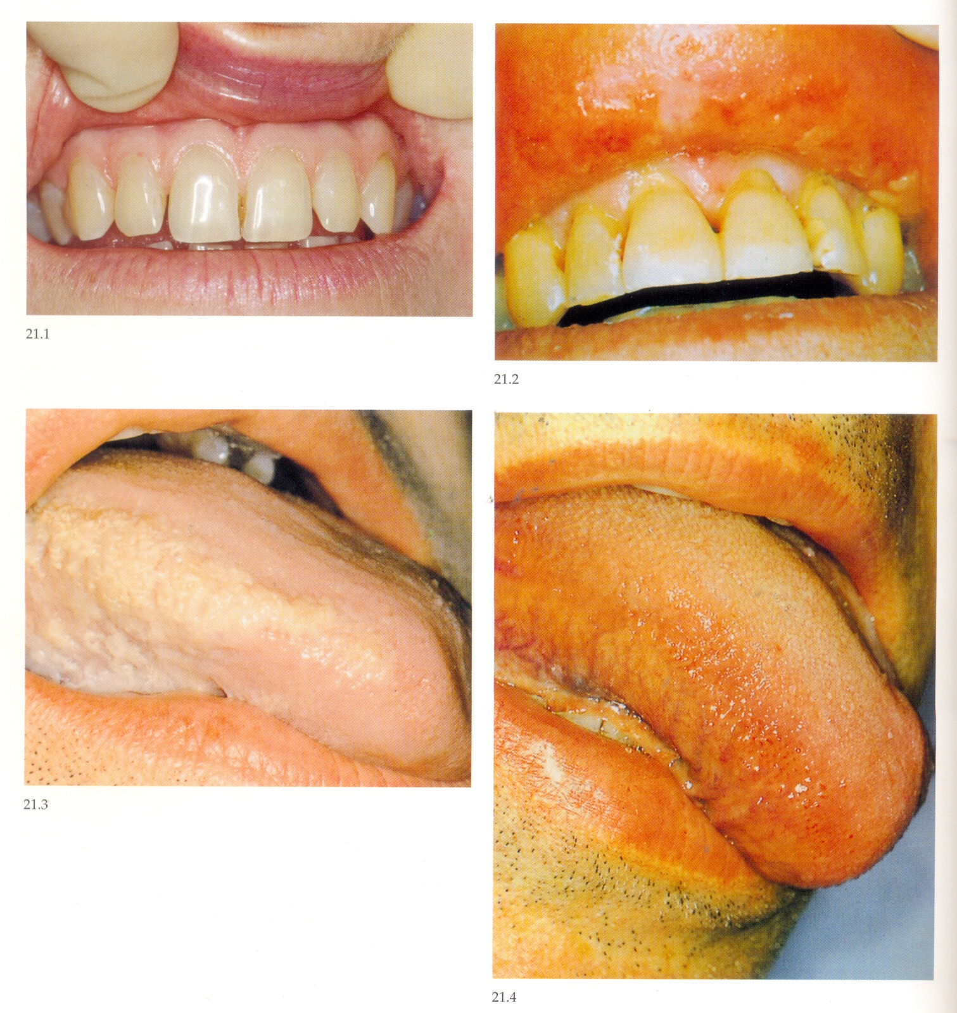
Uremic stomatitis lesions resolved after
With white lesions renal dialysis or
on tongue transplantation.

Slide 12
5.Renal Osteodystrophy (RO) or Sec. HPTH
a. Bone demineralization
b.Loss of trabeculation
c.Ground – glass appearance
d.Total or partial loss of Lamina dura
e.Giant cell lesions or brown tumors
f.Metastatic calcifications
g.Tooth mobility
h.Malocclusion

Slide 13
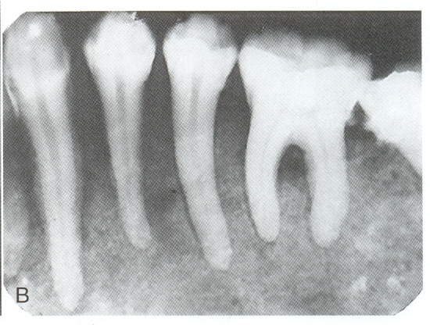
Loss of bone results in the radioopaque teeth standing out in contrast to the radiolucent jaws and loss of lamina dura

Slide 14
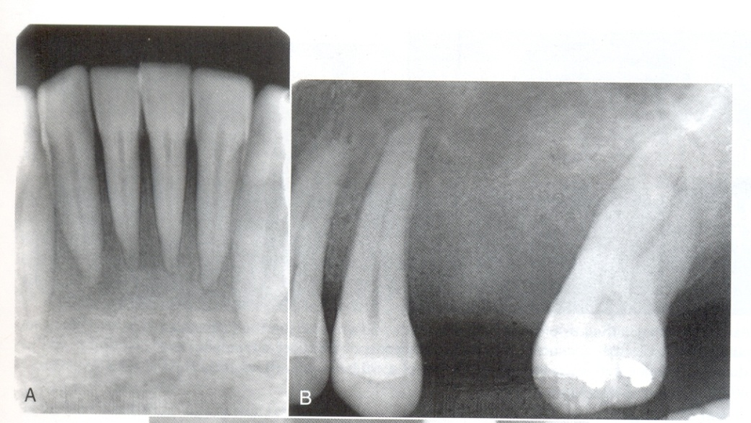
Granular bone pattern and loss of distinct lamina dura and floor of the maxillary antrum

Slide 15
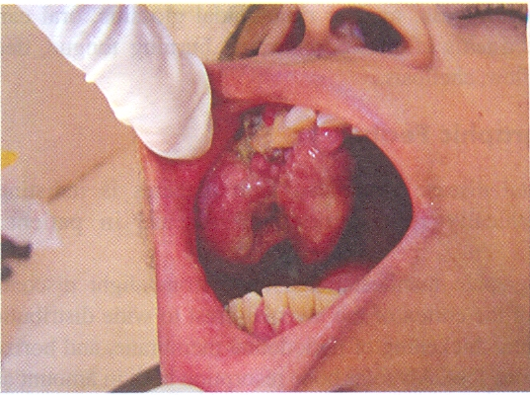
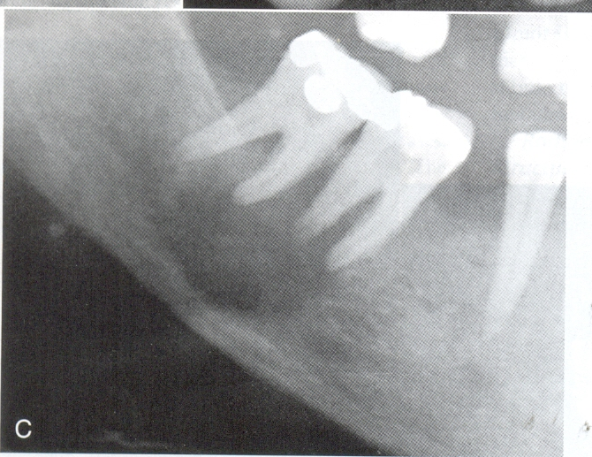
Brown tumour

Slide 16
6.Socket Sclerosis
7.Pulpal narrowing and calcifications
8.Severe tooth erosion
9.Gingival bleeding

Slide 17
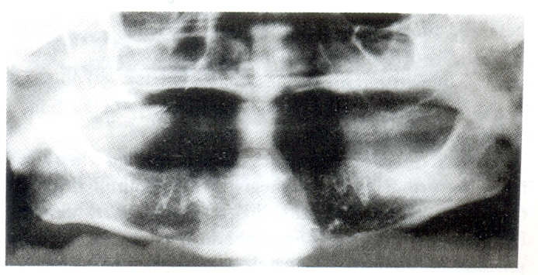
Socket sclerosis

Slide 18
Oral and Radiographic manifestations of Renal disease and Dialysis
Oral Manifestations
1.Enlarged(asymptomatic) salivary glands.
2.Decreased salivary flow.
3.Dry mouth
4.Odour of urea on breath.
5.Metallic taste.
6.Increased calculus formation.
7.Low caries rate.
8.Enamel hypoplasia.

Slide 19
9.Dark brown stains on crowns
Extrinsic(ferrous sulphate therapy)
Intrinsic (tetracycline staining)
10.Dental malocclusions.
11.Pale mucosa.
12.Low grade gingival inflammation.
13.Petechiae & ecchymosis.
14.Bleeding from gingiva.
15.Prolonged bleeding.
16.Candidial infection.
17.Burning and tenderness of mucosa.
18.Erosive glossitis.
19.Tooth erosion.
20.Dehiscence of wounds.

Slide 20
Pallor of the mucosa(chronic anaemia)
Ulcers of the mucosa

Slide 21
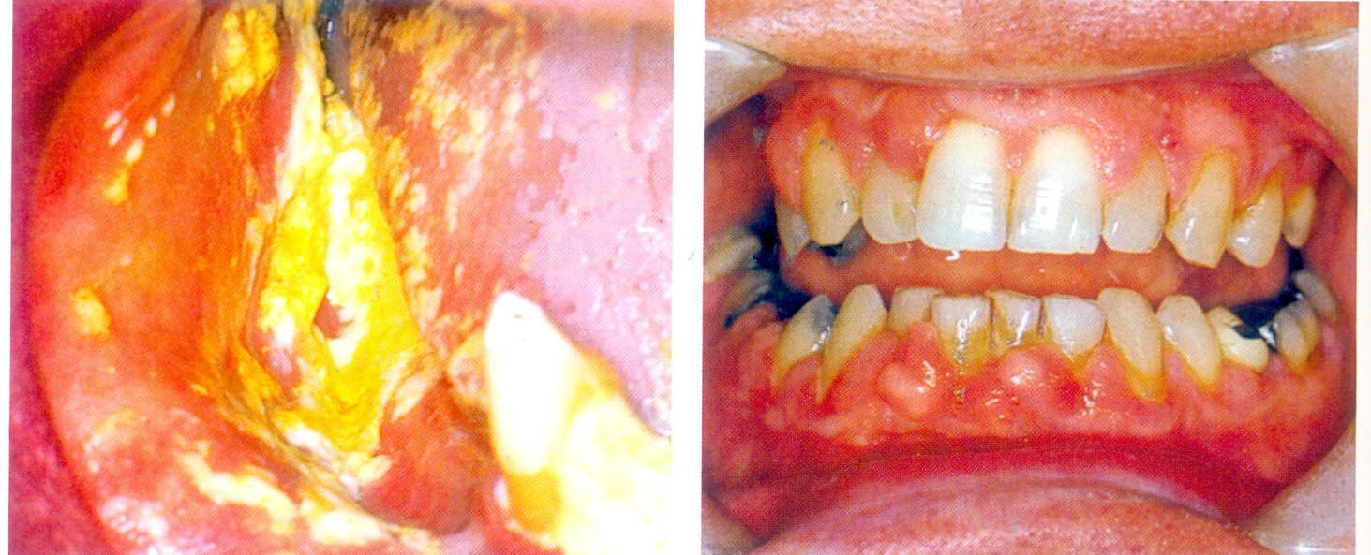
Oral candidiasis and gingival swelling in renal transplantation patients

Slide 22
Radiographic Manifestations.
1.Demineralization of bone.
2.Loss of bony trabeculation.
3.Ground-glass appearance.
4.Loss of lamina dura.
5.Giant cell lesions “brown tumors”.
6.Socket sclerosis.
7.Pulpal narrowing and calcification.
8.Tooth mobility.
9.Arterial and oral calcifications.

Slide 23
MEDICAL MANAGEMENT OF CHRONIC RENAL FAILURE
1.CONSERVATIVE THERAPY
2.RENAL REPLACEMENT THERAPY

Slide 24
CONSERVATIVE THERAPY :-
BEANS – a practical clinical approach
B – Blood pressure < 130 / 85mm Hg (use of ACE inhibitors)
E – Hb Levels 10 to 12 g/dl with erythropoietin
A – Access for dialysis, Serum creatinine >4.0mg /dl or GFR < 20ml / min
N – Nutritional status
S – Specialist evaluation by a nephrologist
serum creatinine >3.0mg / dl.

Slide 25
RENAL REPLACEMENT THERAPY :-
A.DIALYSIS
B.RENAL TRANSPLANTATION
A.DIALYSIS
1.Hemodialysis
2.Peritoneal dialysis

Slide 26
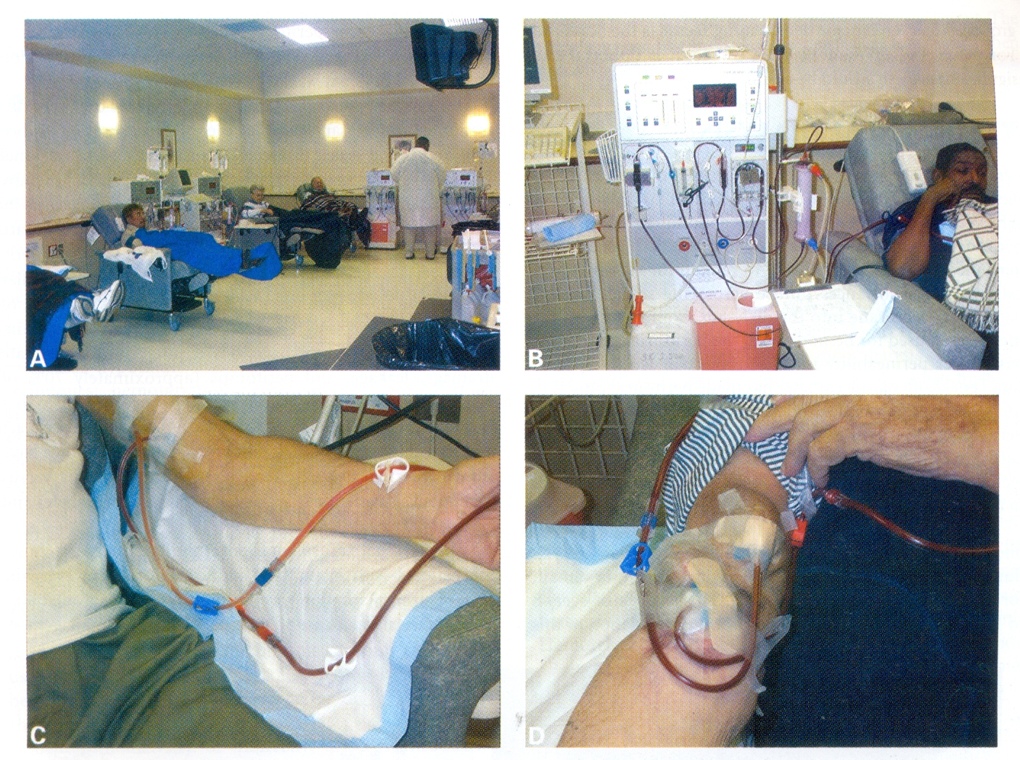
Hemo Dialysis

Slide 27
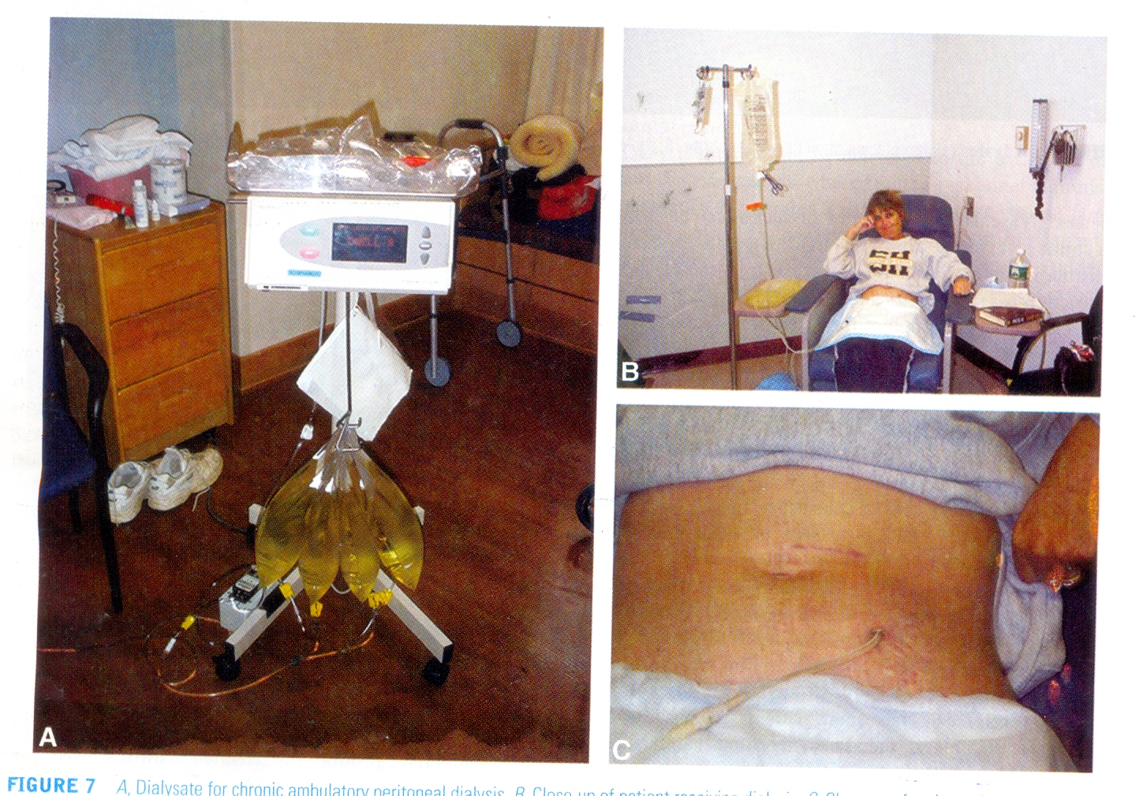
Peritoneal Dialysis

Slide 28
ORAL HEALTH CONSIDERATIONS IN RENAL FAILURE PATIENTS
ACUTE RENAL FAILURE PATIENTS
Elective dental care – deferred
Peritoneal dialysis – not contraindicated

Slide 29
CHRONIC RENAL FAILURE AND END – STAGE RENAL DISEASE PATIENTS
1.Excessive bleeding controlled by
DDAVP
Tranexamic acid
Local haemostatic aids-microfibrillar collagen & oxidized regenerated cellulose
2.Dental treatment – on the day after dialysis
3.IM or IV inj.
Avoided to the arm with vascular access site
Access site in the leg – avoid sitting for long periods

Slide 30
4.Susceptibility to infections – avoided by
Good home care,
OH maintenance
Antifungal & antimicrobial oral rinses.
5.Infective endocarditis –can be prevented by prophylactic antibiotic – Amoxicillin
Allergic to pencillin
clindamycin or oral clarithromycin or IV vancomycin .
6.Periodic testing for Hep. B & C,HIV &TB – affects the dental care
7.B.P. readings – prior to & during dental procedures

Slide 31
8.Sedative premedication – for stressful procedures
9.Pharmaco therapeutics
Safe: - Azithromycin, Doxycycline, cloxacillin, metronidazole, Lidocaine, Paracetomol, Diazepam etc.
Avoid: - Aminoglycosides, sulphonamides, Tetracyclines
Less Safe: - Cephalosporins, ciprofloxacin, ofloxacin, NSAIDS & Aspirin
Fairly safe: - Amp. Amox, Lincomycin, Clindamycin, Pen., Codein
10.Renal Transplantation patients
- Eliminate dental & oral infections before transplantation.

Slide 32
SUMMARY OF DENTAL CONSIDERATIONS AND MANAGEMENT OF THE PATIENT WITH RENAL DISEASE
BEFORE TREATMENT
1.Determine dialysis schedule and treat on day after dialysis
2.Consult patient’s nephrologist for recent laboratory tests & antibiotic prophylaxis
3.Identify arm with vascular access – avoid BP measurement & IM or IV inj.
4.Evaluate patient for hypertension / hypotension
5.Institute preoperative haemostatic aids
6.Determine under lying cause of renal failure
7.Obtain routine annual dental radiographs to establish presence of renal osteodystrophy
8.Consider routine serology for HBV, HCV and HIV antibody
9.Consider antibiotic prophylaxis
10.Consider sedative premedication for patients with hypertension.

Slide 33
DURING TREATMENT
1.Perform a thorough history and physical examination for oral manifestations
2.Aggressively eliminate sources of infection / bacteremia
3.Use haemostatic aids during oral/periodontal surgical procedures
4.Maintain the patient in a comfortable uncramped position in the dental chair
5.Allow the patient to walk or stand intermittently during long procedures.

Slide 34
AFTER TREATMENT
1.Use postsurgical haemostatic agents
2.Encourage meticulous home care
3.Institute therapy for xerostomia
4.Consider use of post operative antibiotics for traumatic procedures
5.Avoid use of respiratory – depressant drugs in the presence of severe anemia
6.Adjust dosages of post operative medications according to the extent of renal failure
7.Ensure routine recall maintenance.

